Slide 1

LiDAR-Enhanced Closed Loop Wake Mixing Control
Aug 2024

Slide 2
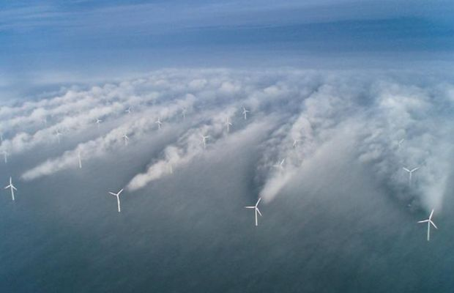
Wake Effect
Effect on downstream WT:
Less power production
Increase structural loads
20 – 45% Loss of Energy
Notes:
The downstream turbine encounters a significantly reduced free-stream velocity compared to the upstream turbine, leading to less energy being available in the flow.

Slide 3
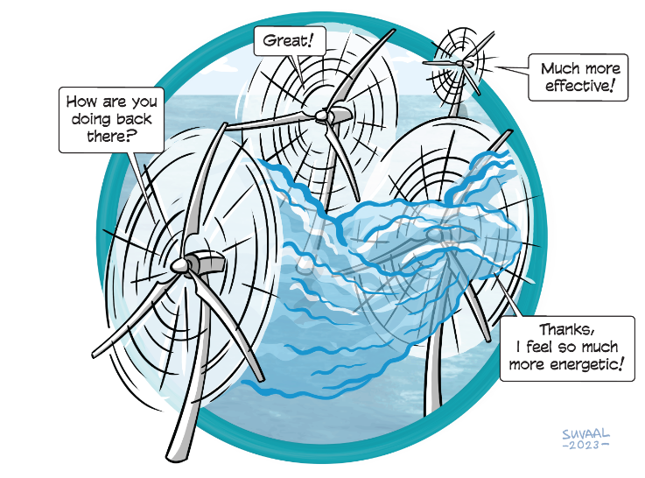
Wind Farm Flow Control
Axial Induction Control
Wake Steering
Wake Mixing

Slide 4
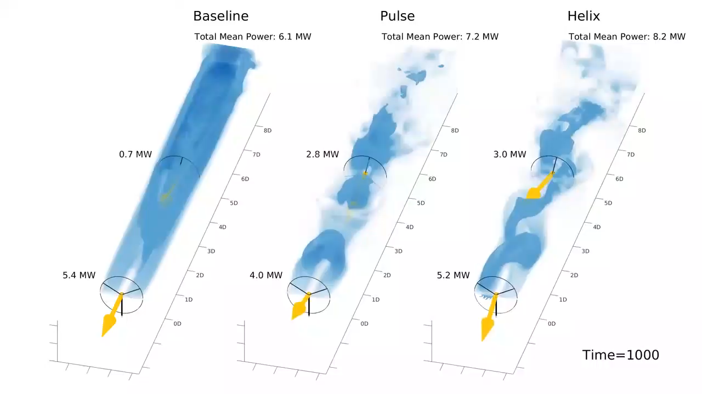
Wake Mixing
Facilitate mixing of free-ambient air and wake for wake recovery
Notes:
The arrow stands for the thrust force
Facilitate mixing of free-ambient air and wake for wake recovery

Slide 5
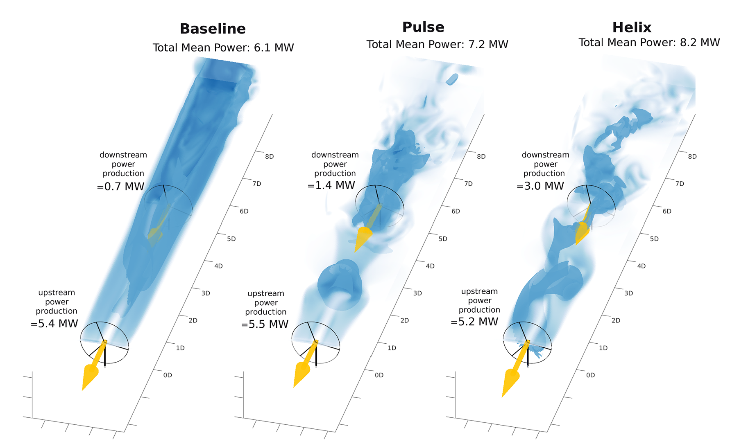
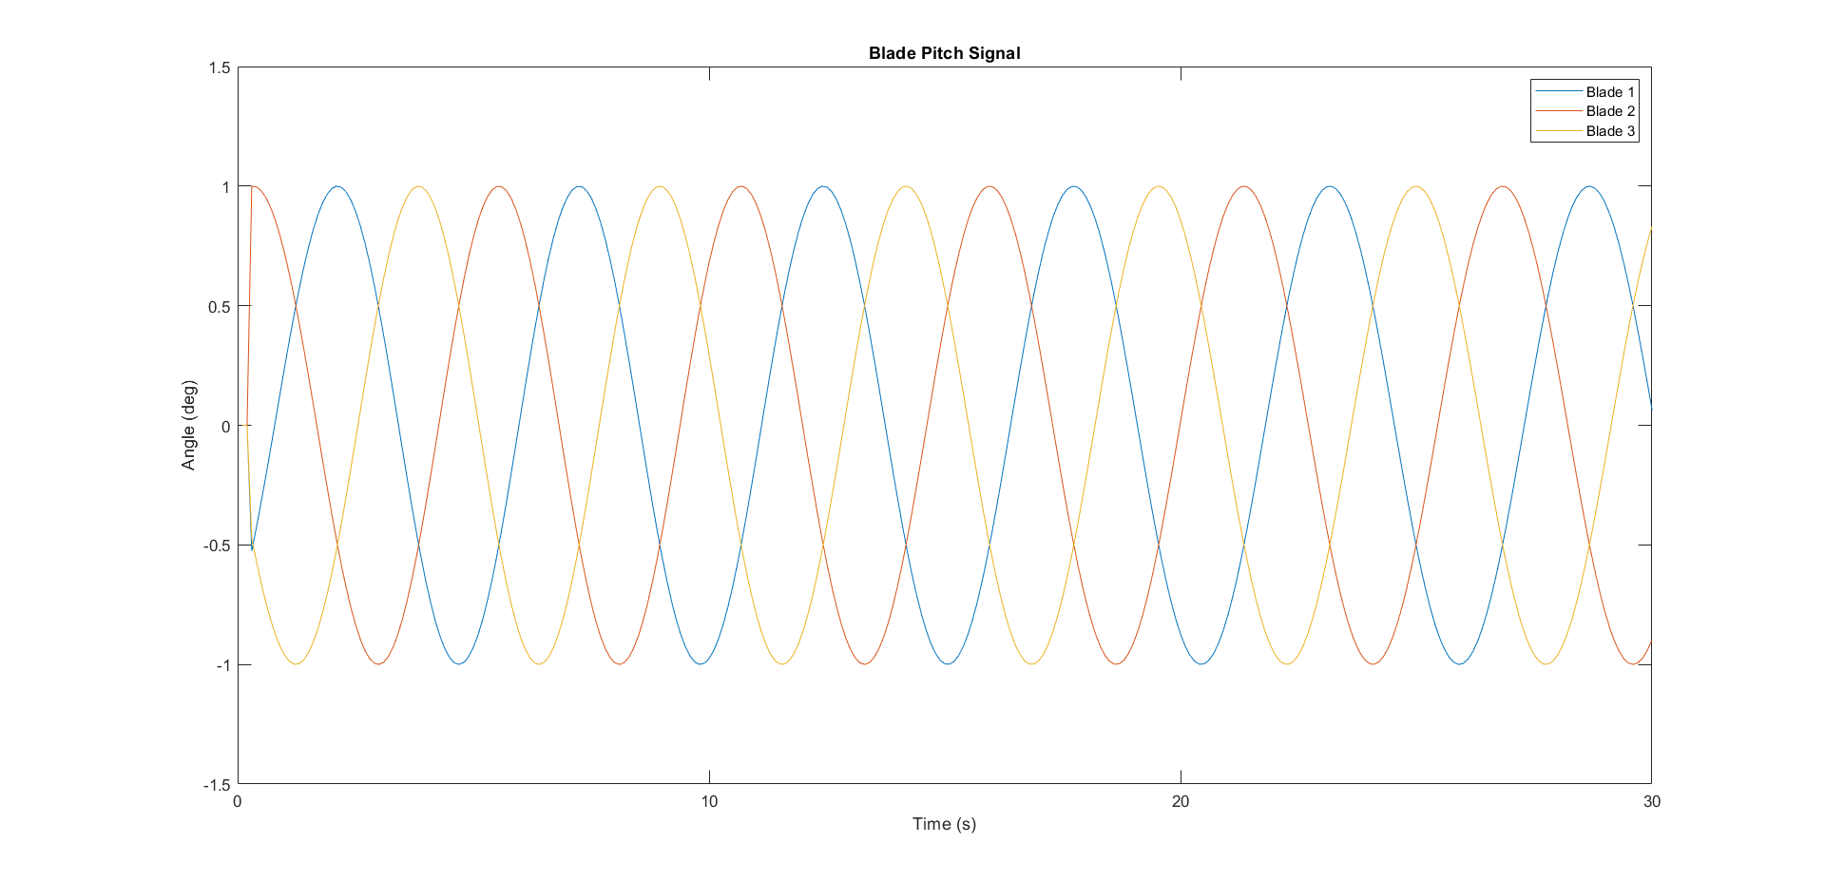
Wake Mixing
Notes:
The wake mixing control strategy is developed to enhance the mixing of the turbine’s wake with ambient free-stream velocity air. This enhanced mixing accelerates the energy recovery of the wake more effectively than would occur through natural wake processes and recovery mechanisms.
Pulse: varying thrust coefficient sinusoidal ----> Load ----> More consistent
Helix: Individual Pitch Control

Slide 6
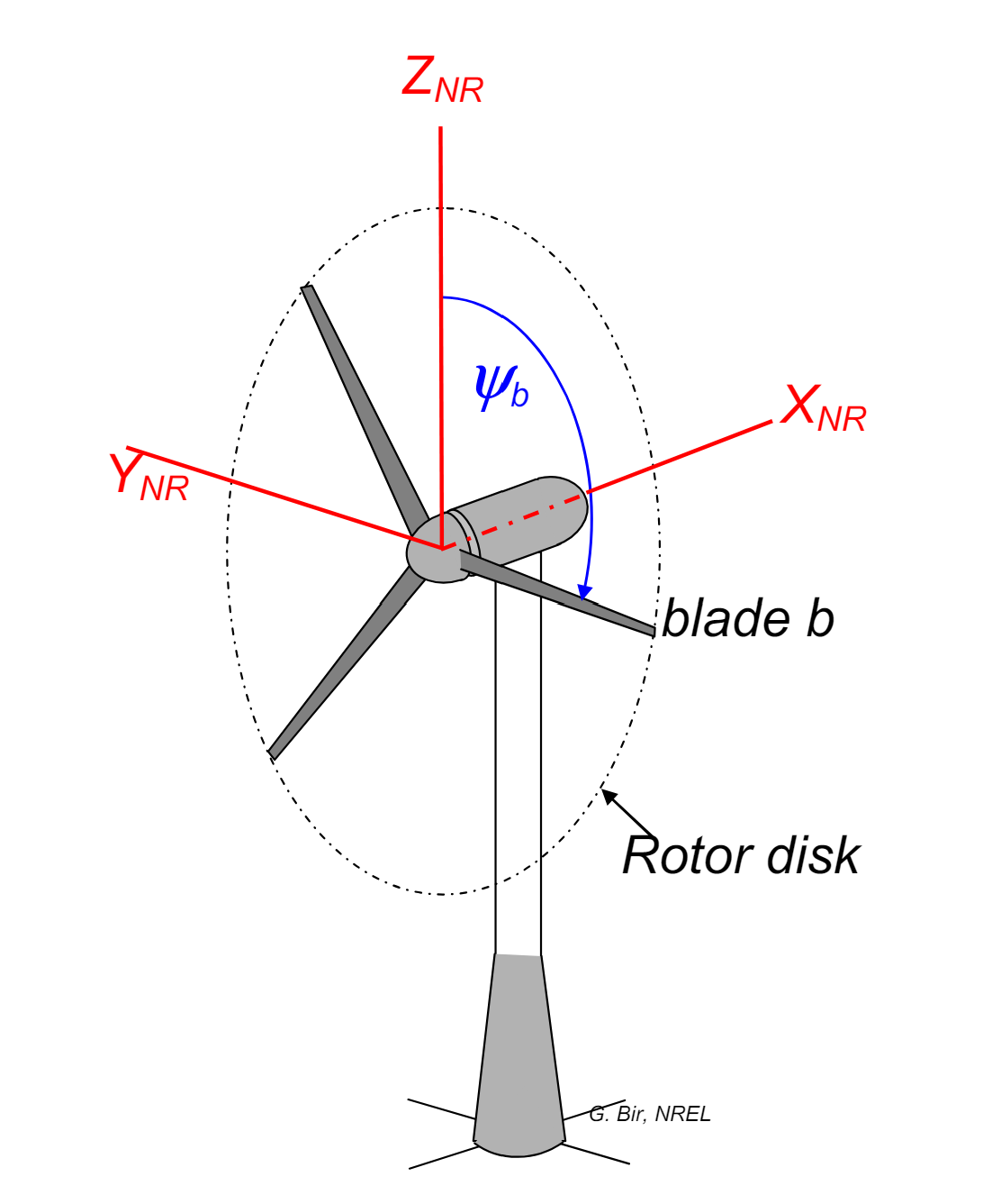
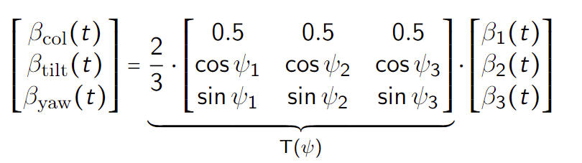
Helix --- MBC Transform
Rotating Frame → Non-rotating Frame
Notes:
MBC transform map the signals from rotating frame to the non-rotating one.
In this fixed frame, the individual pitch commands can be computed as decoupled collective, tilt, and yaw pitch commands respectively, allowing simple SISO control loops instead of MIMO

Slide 7
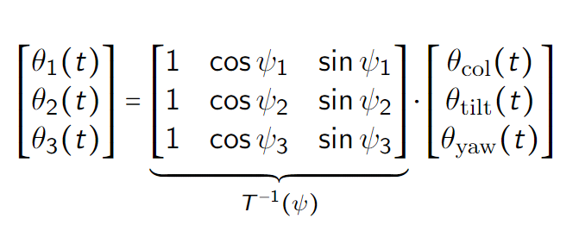
Helix --- Inverse MBC Transform
Non-rotating Frame → Rotating Frame
Notes:
By using the inverse MBC, we just need to give the tilt and yaw moment, then the blade pitch signals are acquired.

Slide 8
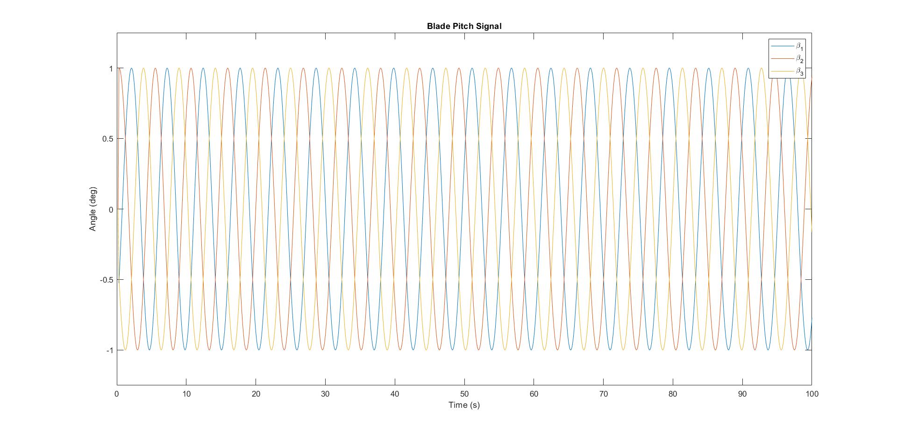
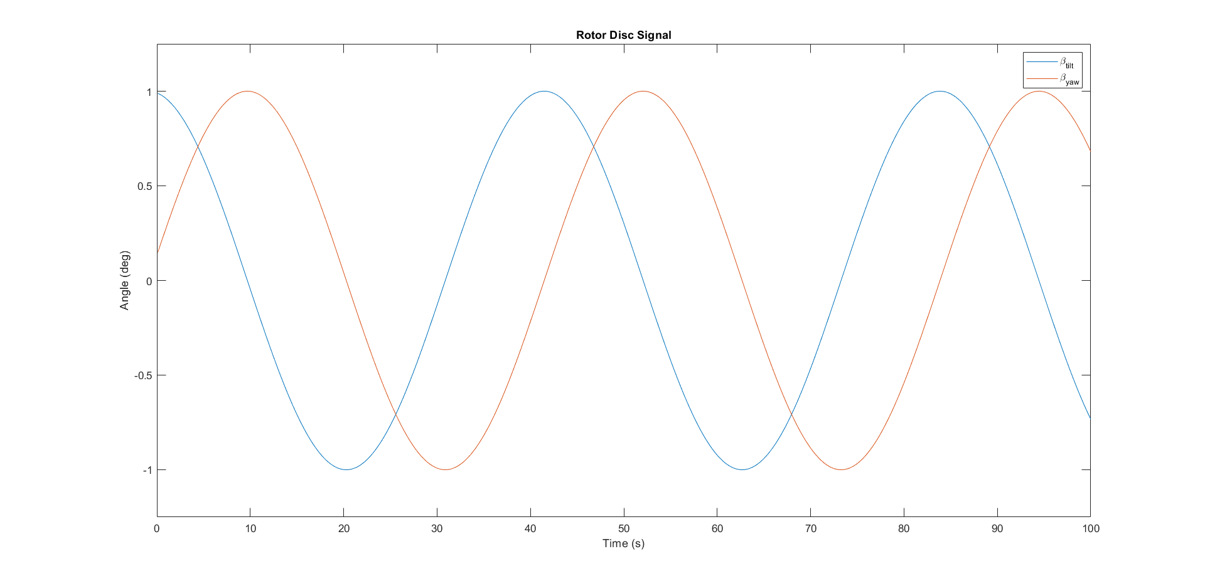
MBC Transform
MBC
Inverse MBC
Notes:
MBC transform map the signals from rotating frame to the non-rotating one.
In this fixed frame, the individual pitch commands can be computed as decoupled collective, tilt, and yaw pitch commands respectively, allowing simple SISO control loops instead of MIMO

Slide 9
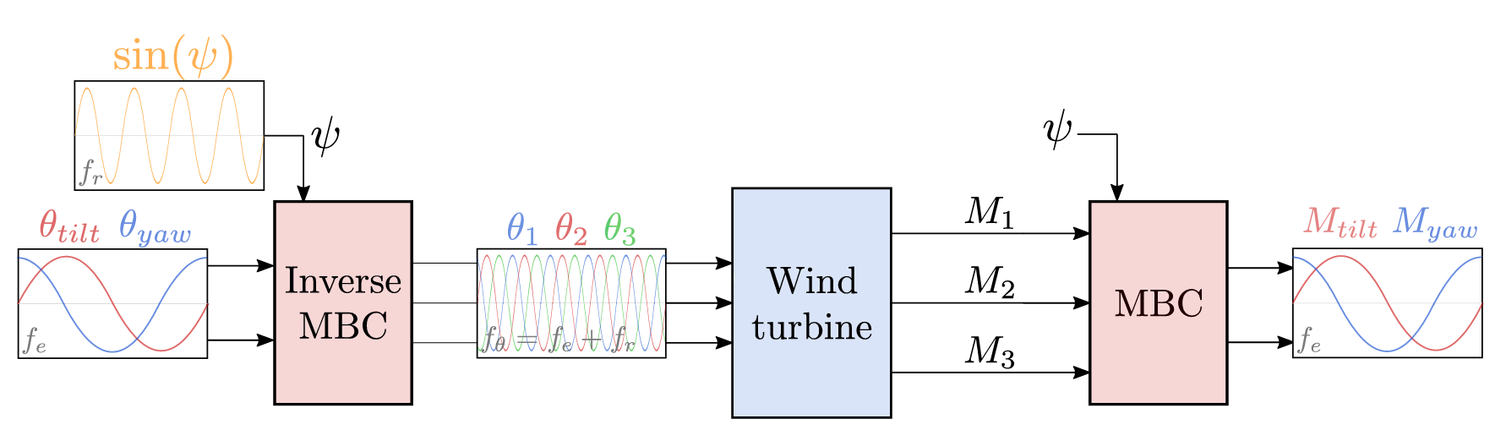
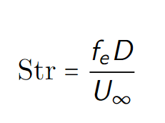
Helix --- Block Diagram
Sinusoidal signals
Frequency
Amplitude
Phase
Notes:
Beta(tilt) and Beta(yaw) for rotor disk, based on the phase different of tilt and yaw, the helix is clockwise or counterclockwise

Slide 10
Gap of the Helix
Open-Loop Control:
No feedback from output
Can we closed-loop control the helix approach based on flow information?
Notes:
Disturbance Rejection
Accuracy and Precision
Input-based control vs. Output-based control: Directly monitors and adjusts the system outputs.

Slide 11
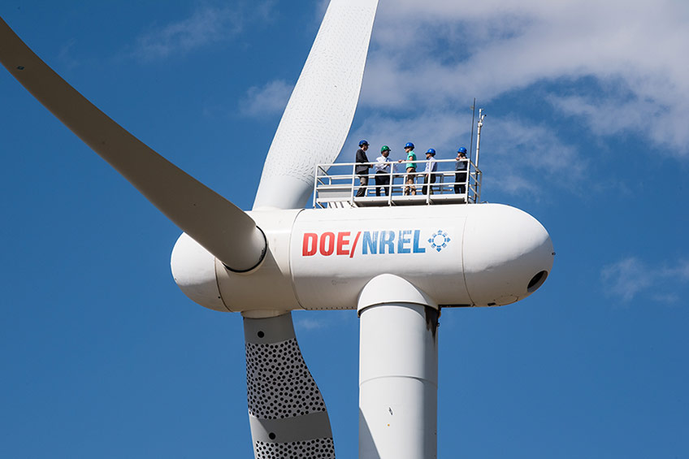
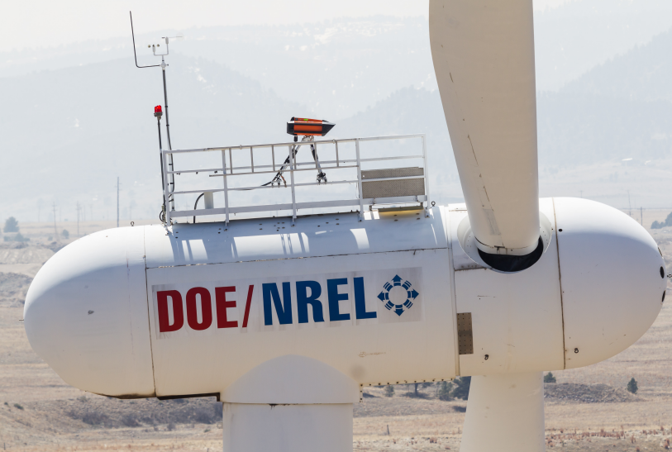
Feedback --- LiDAR
Notes:
To close the loop, one of the most important things is to get the feedback --- LiDAR

Slide 12
Research Question
How to integrate LiDAR and the helix approach for closed-loop wake mixing control for wind farms?
Which LiDAR configuration to use?
What feature in the helix wake should be controlled, and how to obtain it using LiDAR?
How to design the control loop to rectify the helix?
Potential for next step?

Slide 13
LiDAR Choosing
Trade off between practicality and quality --- Modified ZX-TM LiDAR
Continuous Wave LiDAR
Measure Distance: 10 – 720 m
Half-cone angle: -
Entire rotor disk

Slide 14
Research Question
How to integrate LiDAR and the helix approach for closed-loop wake mixing control for wind farms?
Which LiDAR configuration to use? √
What feature in the helix wake should be controlled, and how to obtain it using LiDAR?
How to design the control loop to rectify the helix?
Potential for next step?
Notes:
So here, we answered the first question, what configuration of LiDAR to be used.

Slide 15
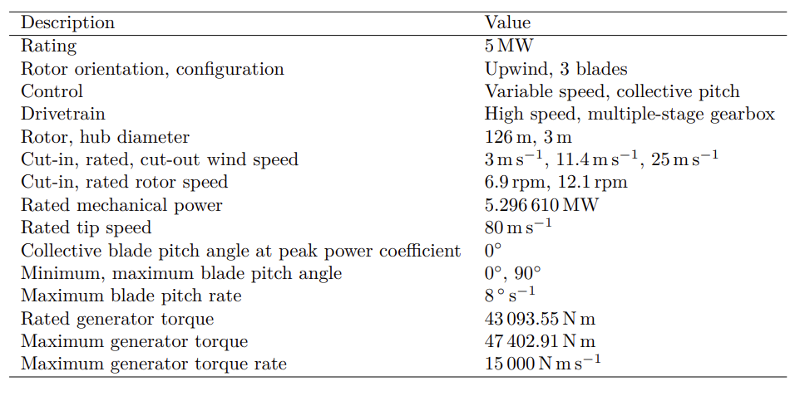


Practical Tool
Notes:
Q-blade
MATLAB
NREL5MW

Slide 16
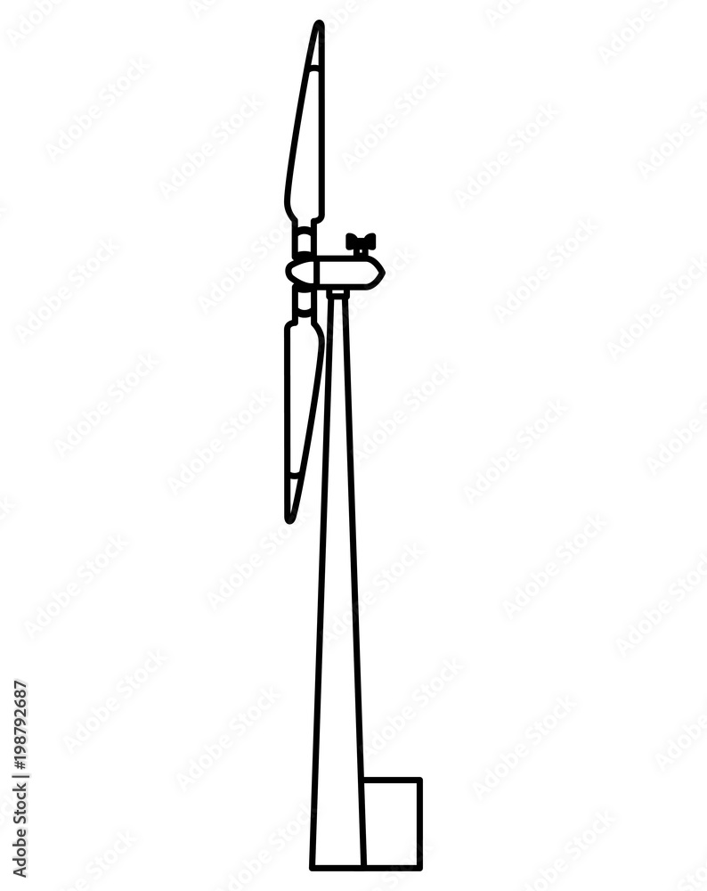
Simulation Setup
1D
1D
Notes:
Downwind facing LIDAR
Measuring 1D (rotor disk) position

Slide 17
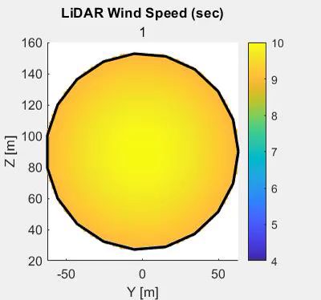
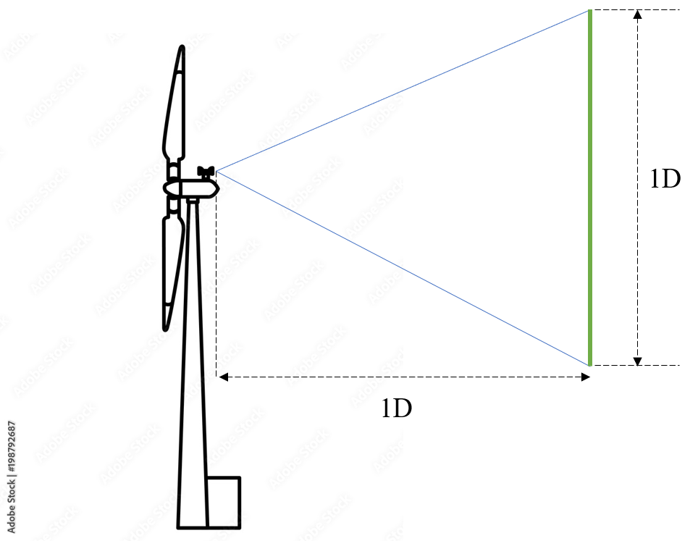
Demo of LiDAR
U = 10 m/s
CCW
Str = 0.3
Amplitude = 3
Notes:
Q-blade doesn’t have any LiDAR functionality, so I spent around a week time to implement the LiDAR functionality and optimize it so that it’s fast enough (2 days --> 10 mins --> 2 mins )
Wake center is what I am aiming at
1. obvious
2. accessible in real-time

Slide 18
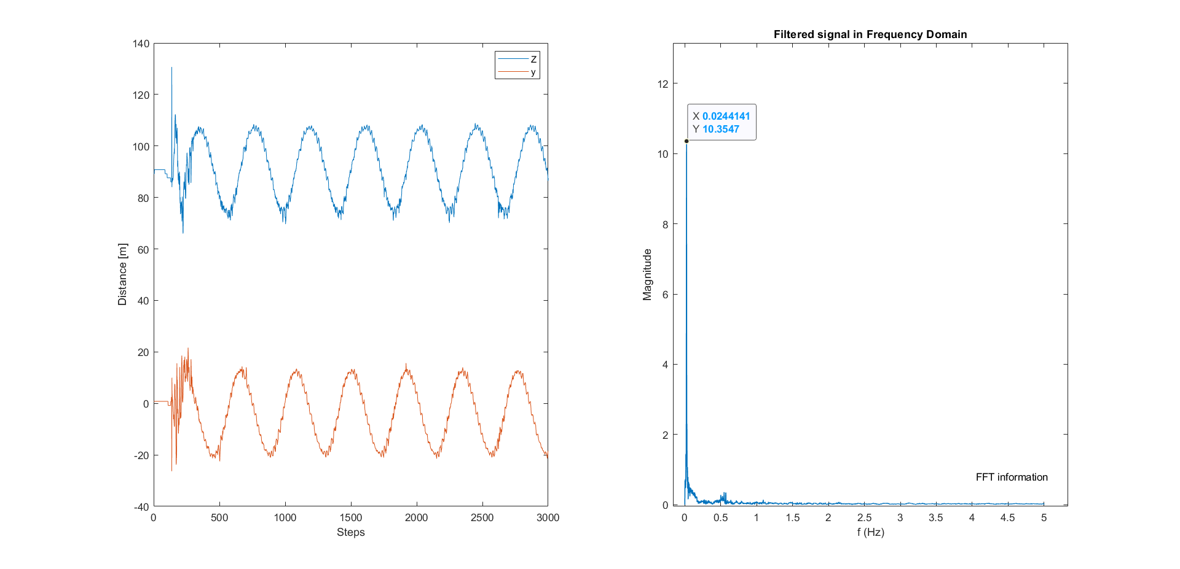
What to control?
Notes:
CCW, coordinate of helix center, two periodic signal

Slide 19
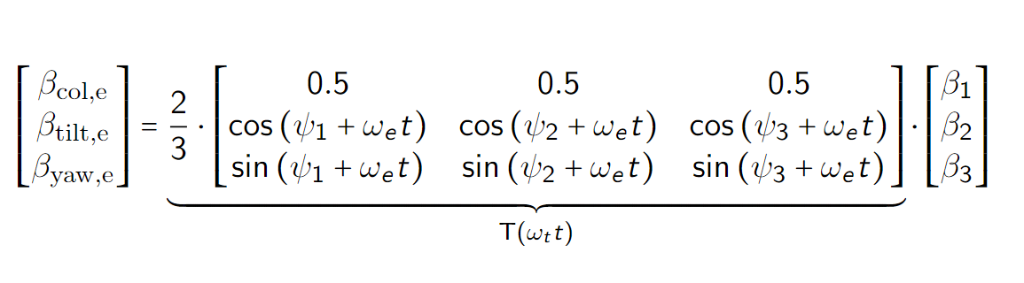
New Transform
Non-Rotating Frame → Helix Frame
1P, 1P+fe → 0P, fe
1P, 1P+fe → 0P, fe → 1P, 0P

Slide 20
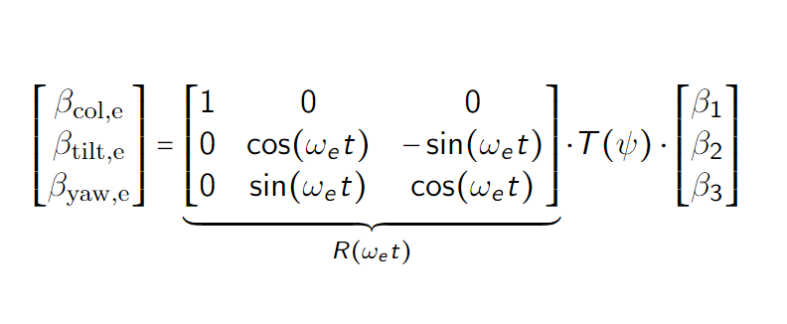
New Transform
Non-Rotating Frame → Helix Frame
1P, 1P+fe → 0P, fe
1P, 1P+fe → 0P, fe → 1P, 0P

Slide 21
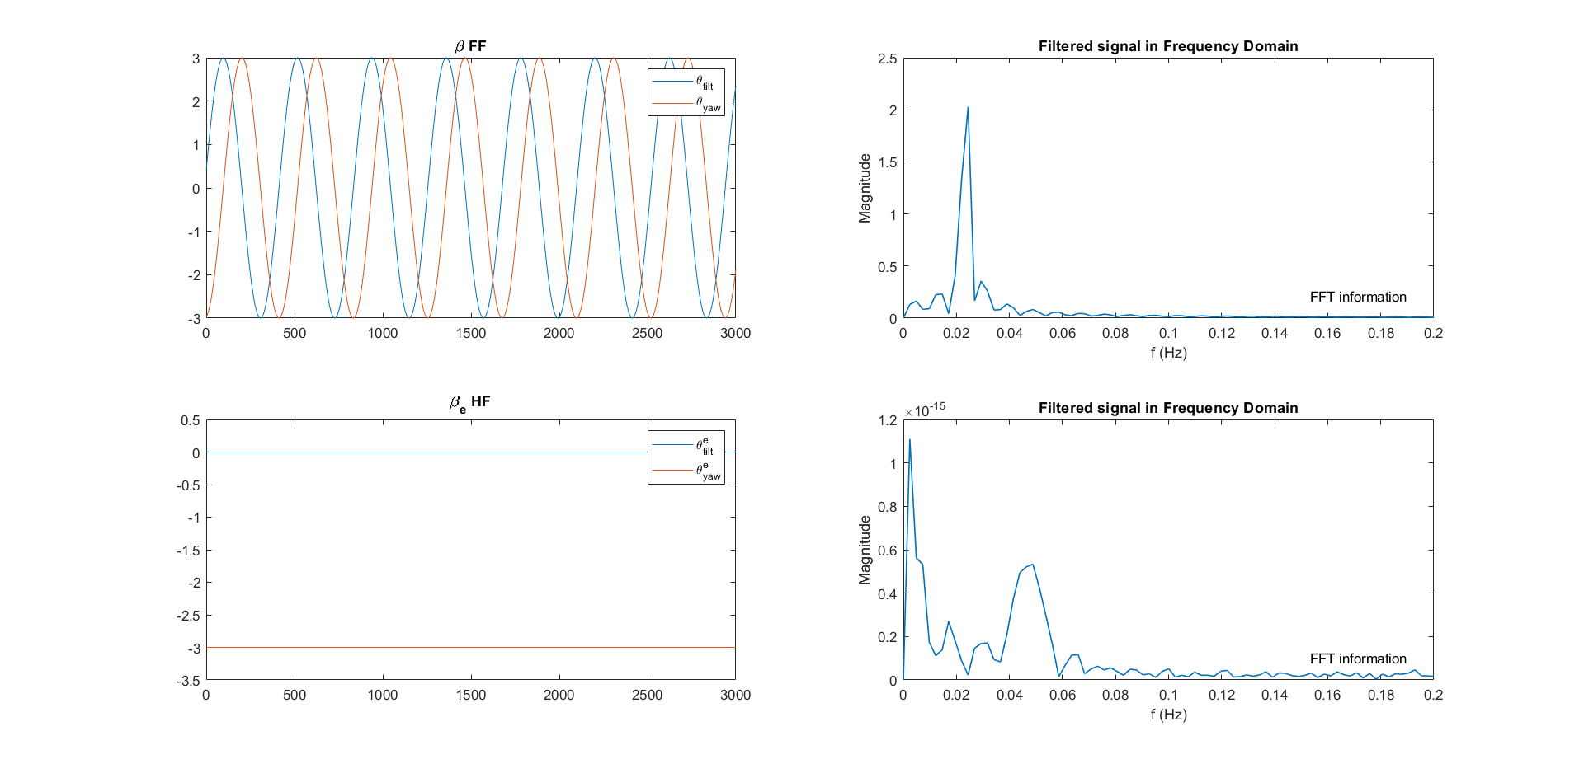
New Transform
Fixed Frame
Helix Frame

Slide 22
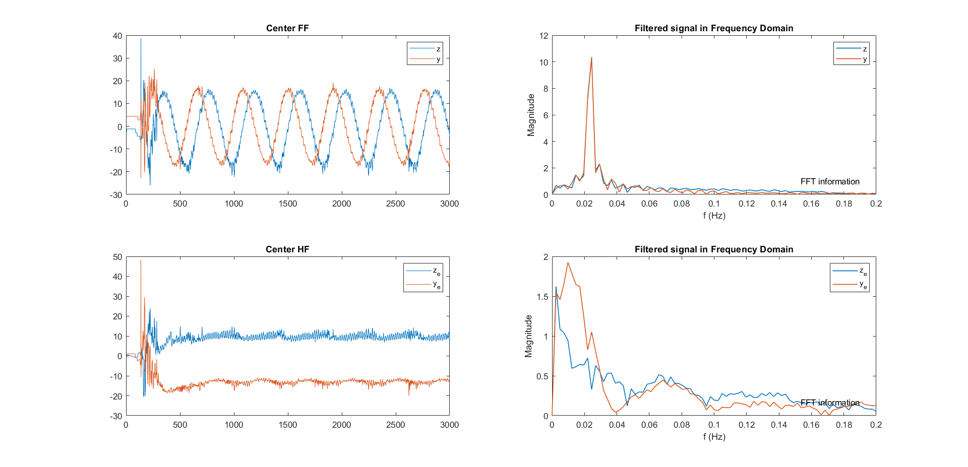
New Transform
Fixed Frame
Helix Frame

Slide 23
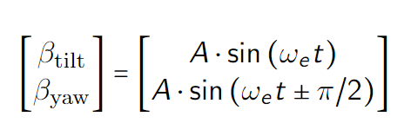
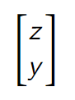
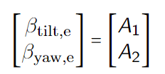
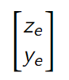
What to control?
Fixed Frame
FF beta
FF center
Helix Frame
HF beta
HF center
Notes:
There are four different combination that can be controlled
We explore the relation between input and output by first open-loop control the whole system

Slide 24
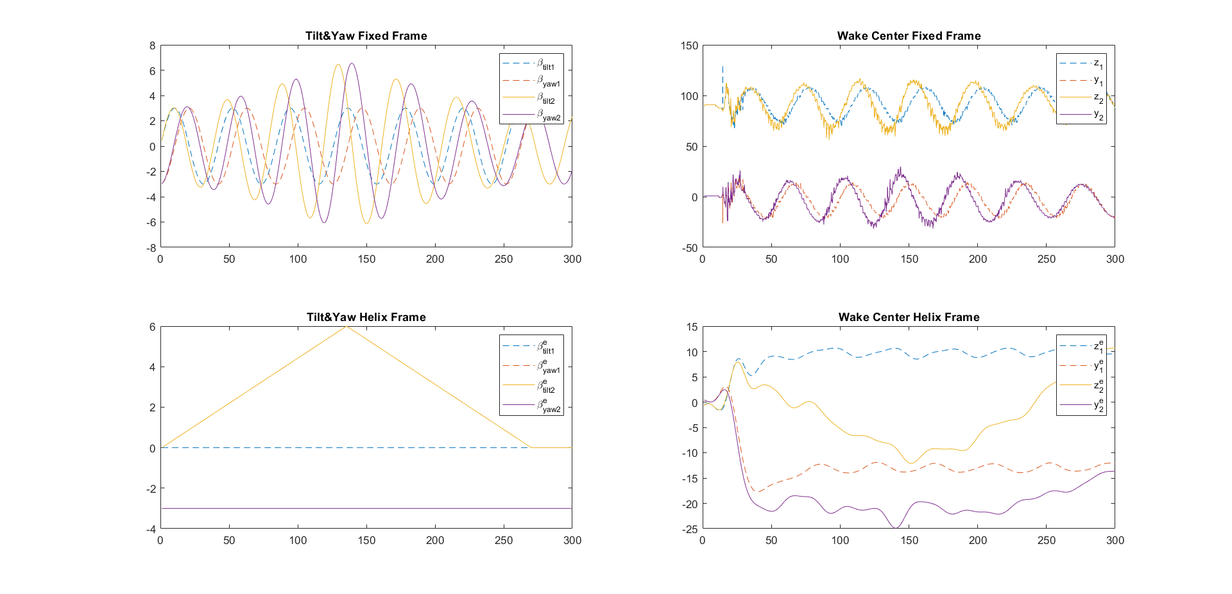
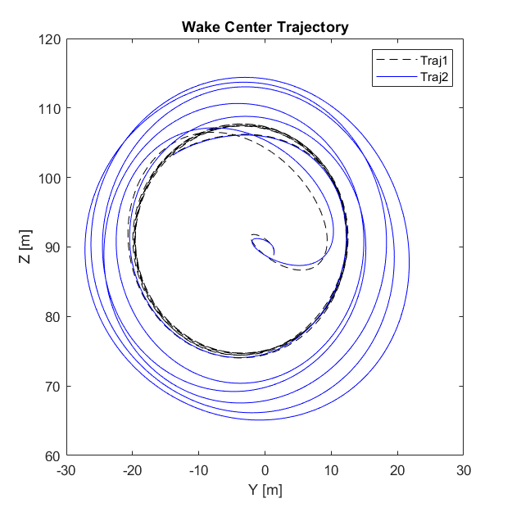
HF beta – HF center
Notes:
The magnitude of the helix as well as the phase can both be manipulated

Slide 25
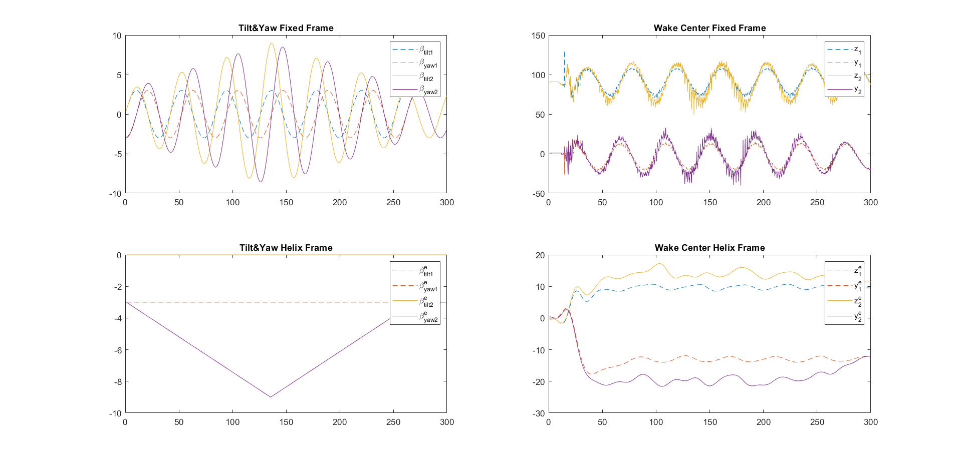
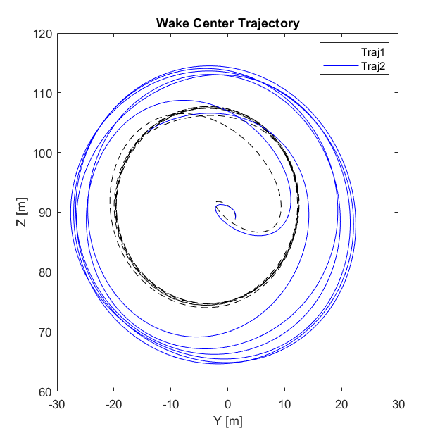
HF beta – HF center
Notes:
First the magnitude of beta tilt and beta yaw

Slide 26
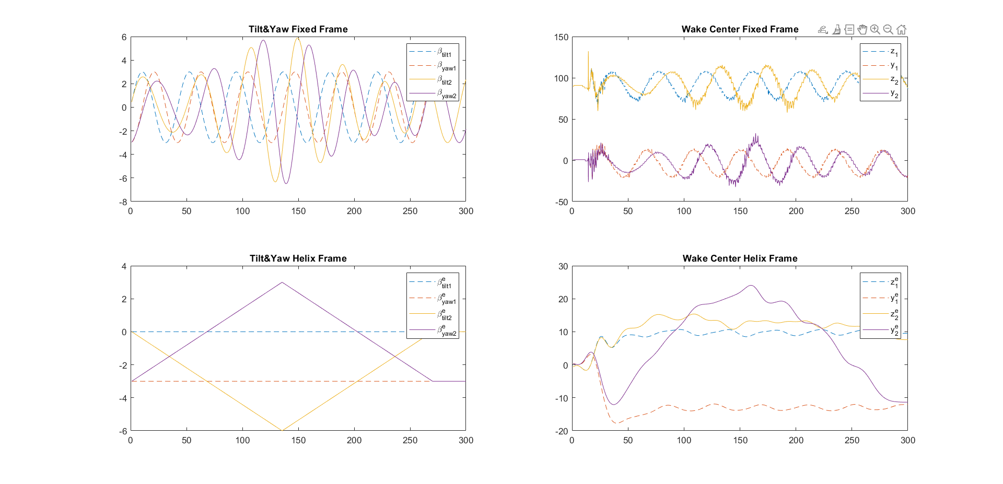
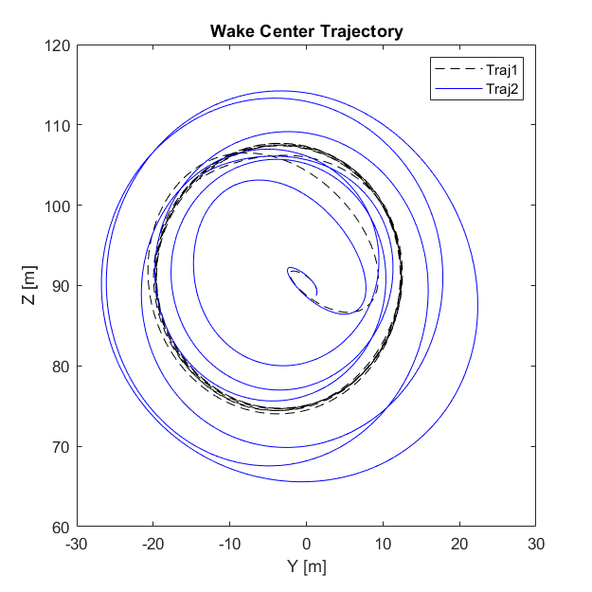
HF beta – HF center
Notes:
First the magnitude of beta tilt and beta yaw

Slide 27
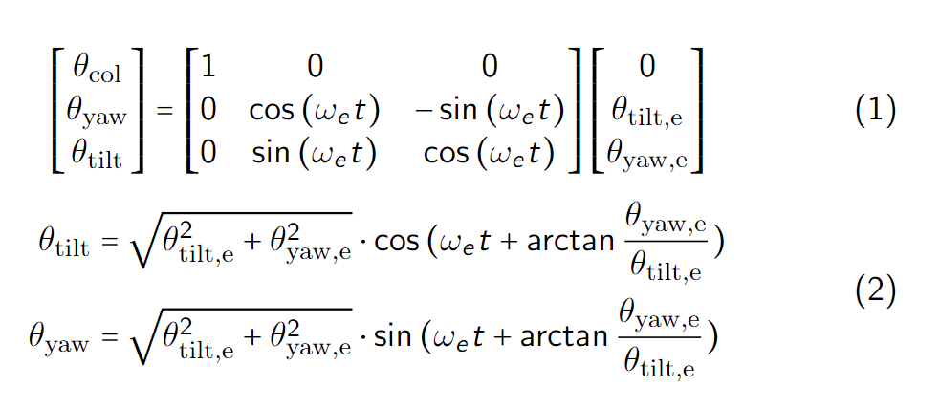
HF beta – HF center Analysis
Coupling between the (z, y)
MIMO system
Phase and magnitude
Both variables are STATIC!

Slide 28
Research Question
How to integrate LiDAR and the helix approach for closed-loop wake mixing control for wind farms?
Which LiDAR configuration to use? √
What feature in the helix wake should be controlled, and how to obtain it using LiDAR? √
How to design the control loop to rectify the helix?
Potential for next step?
Notes:
So here, we answered the first question, what configuration of LiDAR to be used.

Slide 29
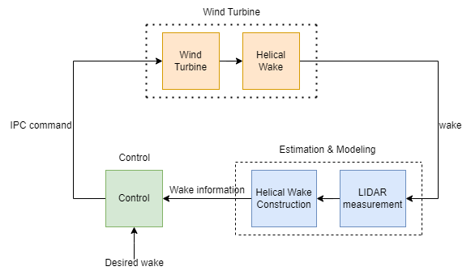
Control System Design
LiDAR Sampling Pipeline
Notes:
Dead-time Delay

Slide 30
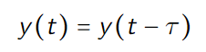
Dead-time Delay
Notes:
Dead-time Delay

Slide 31
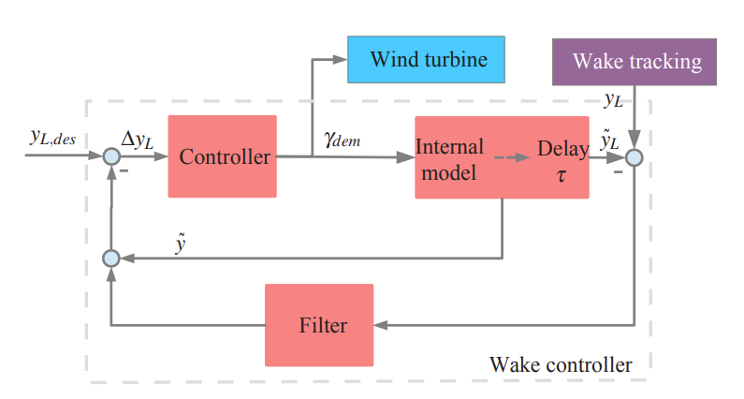
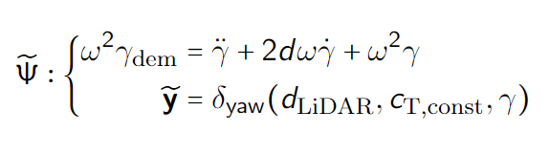
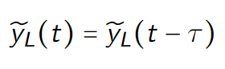
Smith Predictor (CL Yaw Ctrl)
Notes:
Equations of internal model and delay.
The internal model predict the reaction of the wake to the demanded yaw angle. The first equation is the relationship of yaw, and then the second one is for the wake.

Slide 32
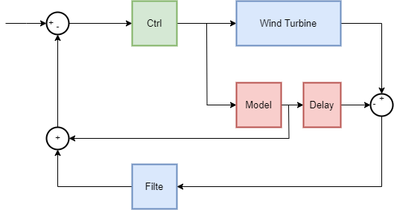
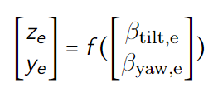
Model-based Control

Slide 33
System IDE --- data processing
Start
Flowchart of LiDAR data processing
Sim Over
Y
N
LiDAR sampling
Helix Center Calculation
LPF
Detrend
Coordinate Transfer
Over

Slide 34
System IDE
Notes:
Dead-time Delay

Slide 35
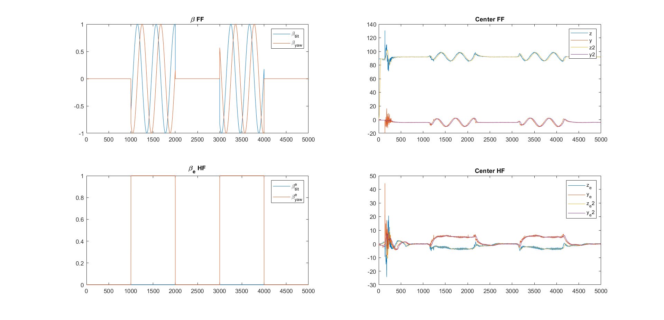
System IDE
Notes:
RGA matrix

Slide 36
Next Step
System IDE (U = 10m/s)
Model-based Controller Tuning
Next step depends on result of 2

Slide 37
Thanks for listening :)

Slide 38
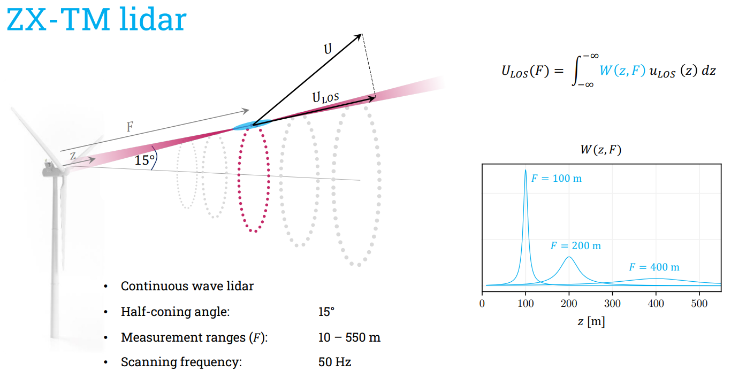

Slide 39
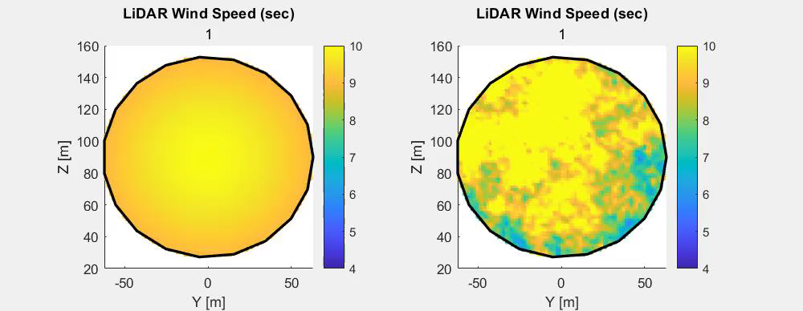
Why closed-loop control?
Notes:
With LiDAR, we are able to visualize the helix downwind, and based on some play arounds, we can answer the question of what to control

Slide 40
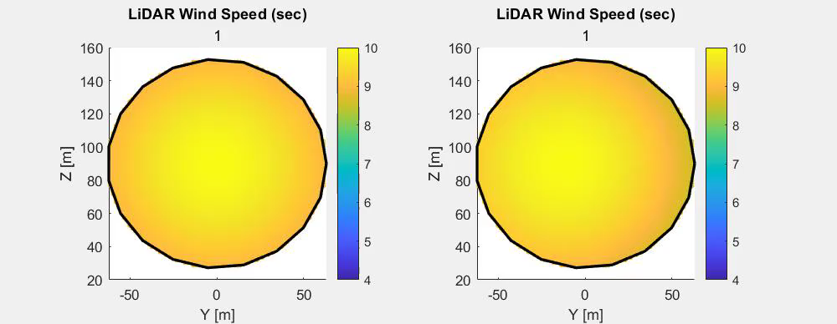
Why closed-loop control?
Notes:
With LiDAR, we are able to visualize the helix downwind, and based on some play arounds, we can answer the question of what to control

